Slide 1


HEP Weekly Report
George Bakas

Slide 2
Weekly Report
Analysis:
Subdominant Bkg Production ‘16,’17
Tried new WP’s to see if contamination will go below 1%. No significant result
Top Tagger:
2016: 0.2
2017: 0.0
2018: 0.1
Fit the Ratio Bkg Signal Region / Bkg Control Region because of the slope it shows for 2017 and 2018 in some variables
Closure Tests with Scale Factors from Fit on the ratio Bkg SR/ Bkg CR
Fit on top Mass variable to extract bkg from data

Slide 3
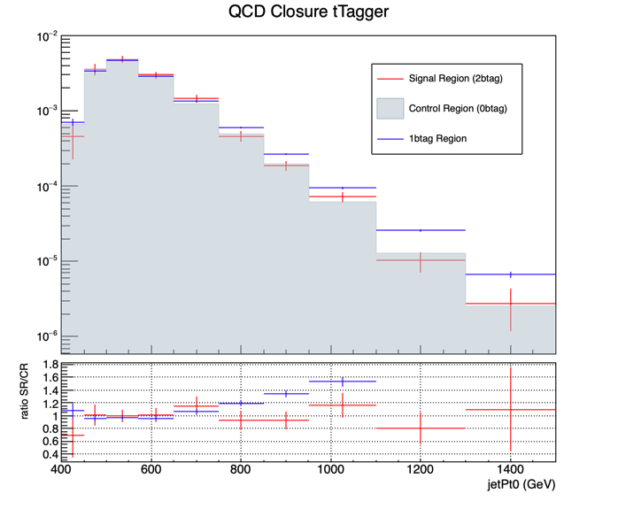
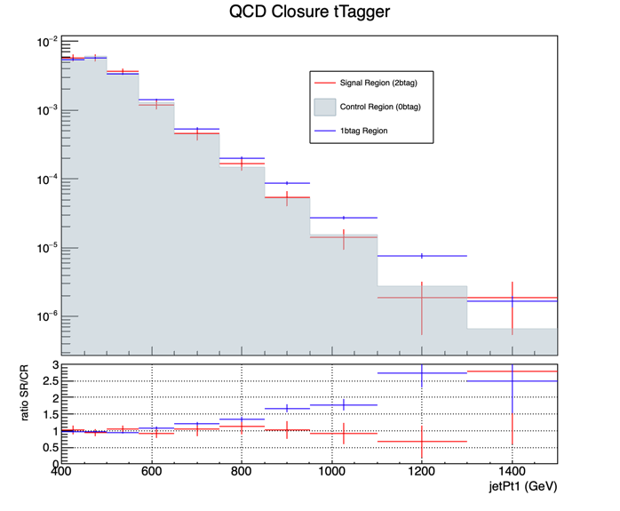
New Closure Tests 2017

Slide 4
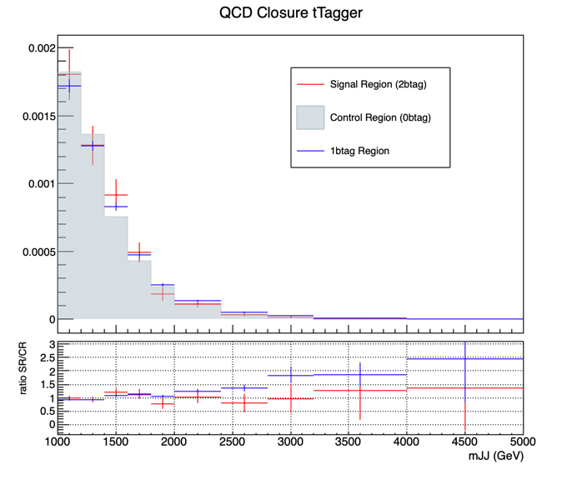
New Closure Tests 2017

Slide 5
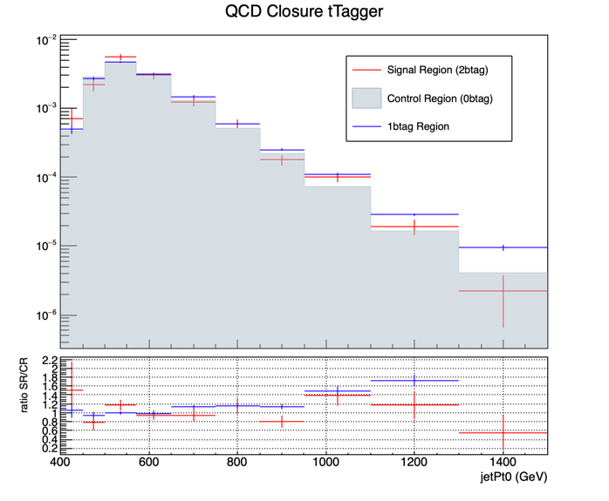
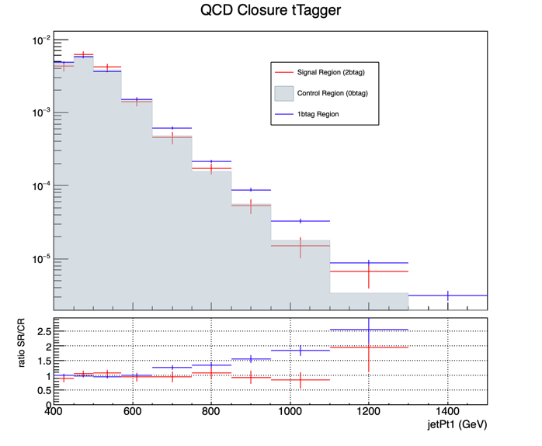
New Closure Tests 2018

Slide 6
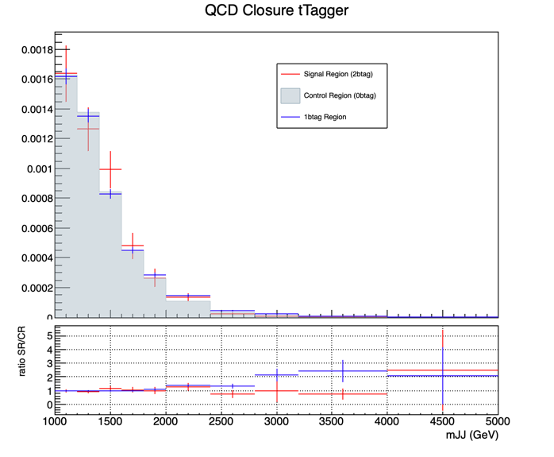
New Closure Tests 2018

